Slide 1


Applied Mathematics at Citi MQA
Markets and Securities Services
27/09/2019
Péter Szőke,
Quantitative Analyst – Assistant Vice President
Public
Notes:
We will illustrate how MQA is structured to deliver the Financial models and opportunities available with Citi, Budapest.

Slide 2
Agenda
Who is a “Quant”?
Markets Quantitative Analysis at Citi
How do we work?
Internship/Career

Slide 3
Who is a “Quant”?
“A quantitative analyst (or, in financial jargon, a quant) is a person who specializes in the application of mathematical and statistical methods to financial and risk management problems.” – Wikipedia
A Person who is
  Applying mathematical tools
  Working on the field of Finance
  Using technological solutions (programming)

Slide 4
Markets Quantitative Analysis
Highly regulated trading environment:
  Quants perform an ever important role
  Ensure the Financial models are fully understood and documented.
Survival of the fast paced environment of the trading desk needs cutting edge
  financial modeling
  tools s
  software engineering
We are extensively involved in the regulatory stress tests which the Firm undertakes, ensuring that our models operate effectively in stressed market conditions.
Who are our people?
Quantitative Developers
Quantitative Support (Devops)
Quantitative Analysts
Who are our clients?
MQA’s key business partners are:
Trading
Structuring
Sales Desks
Risk Organization
Valuation and Control
Technology Risk teams.
Business Areas:
Credit
Equities & Hybrids
Mortgages
Commodities
FX
Rates

Slide 5

Markets Quantitative Analysis
Where are we located ?
MQA is a global department of around 370 people, predominantly in North America and London with a small number in Asia.
We established a presence in Budapest in September 2013.
New York
London
Budapest
Houston
Tokyo
Hong Kong
Singapore
Sydney

Slide 6
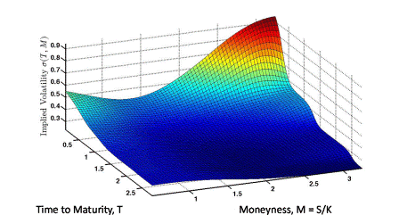
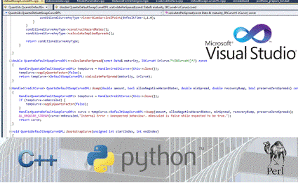

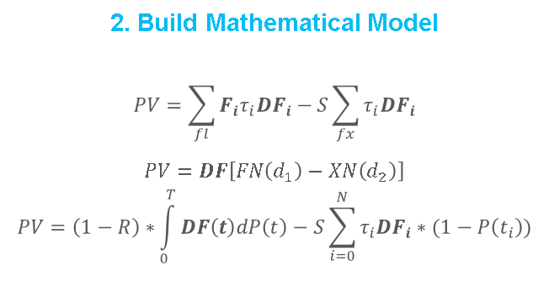
Markets Quantitative Analysis
How do we work?
1. Observe Market Behavior
2. Build Mathematical Model
$$PV=\sum_{fl}{F_{i}τ_{i}{DF}_{i}}−S\sum_{fx}{τ_{i}{DF}_{i}}$$
$$PV=DF\left[FN\left(d_{1}\right)−XN\left(d_{2}\right)\right]$$
$$PV=\left(1−R\right)∗\int_{0}^{T}{DF\left(t\right)dP\left(t\right)−S\sum_{i=0}^{N}{τ_{i}DF_{i}∗(1−P\left(t_{i}\right))}}$$
3. Implementation
4. Deliver

Slide 7
Markets Quantitative Analysis
How do we work?
1. Observe Market Behavior
2. Build Mathematical Model
$$PV=\sum_{fl}{F_{i}τ_{i}{DF}_{i}}−S\sum_{fx}{τ_{i}{DF}_{i}}$$
$$PV=DF\left[FN\left(d_{1}\right)−XN\left(d_{2}\right)\right]$$
$$PV=\left(1−R\right)∗\int_{0}^{T}{DF\left(t\right)dP\left(t\right)−S\sum_{i=0}^{N}{τ_{i}DF_{i}∗(1−P\left(t_{i}\right))}}$$
3. Implementation
4. Deliver

Slide 8
Knowledge of financial products
  Types of derivatives
  Understand risk, XVA, etc.
  Problem definition
  Extending existing models

Slide 9

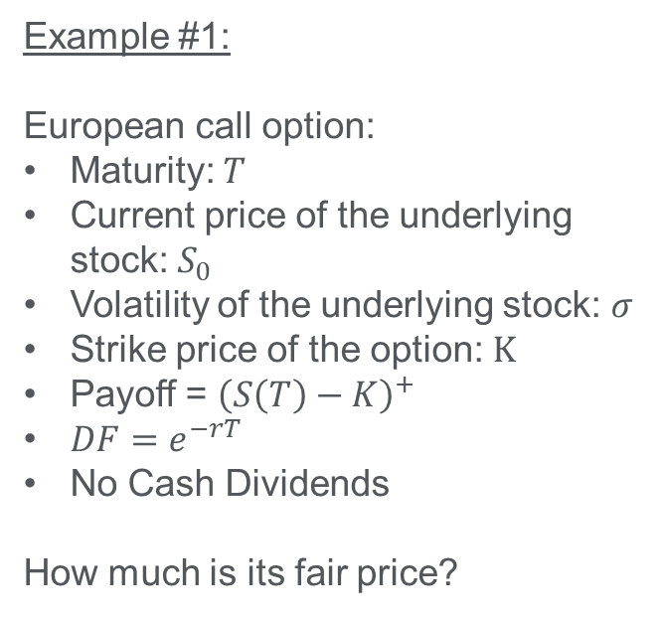
Knowledge of financial products
  Types of derivatives
  Understand risk, XVA, etc.
  Problem definition
  Extending existing models
Example #1:
European call option:
Maturity: $T$
Current price of the underlying stock: $S_{0}$
Volatility of the underlying stock: $σ$
Strike price of the option: $K$
Payoff = ${\left(S\left(T\right)−K\right)}^{+}$
$DF=e^{−rT}$
No Cash Dividends
How much is its fair price?
$$C\left(T,K,S_{0},σ\right)=S_{0}N\left(d_{1}\right)−e^{−rT}KN\left(d_{2}\right) \\ d_{1;2}=\frac{ln\left(\frac{S_{0}}{K}\right)+\left(r±\frac{1}{2}σ^{2}\right)T}{σ\sqrt{T}}$$
Nobel Price awarded formula (1997)

Slide 10
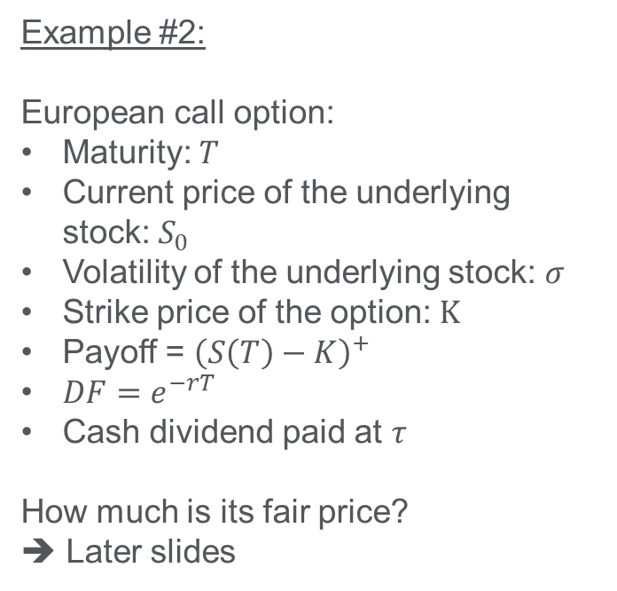
Knowledge of financial products
  Types of derivatives
  Understand risk, XVA, etc.
  Problem definition
  Extending existing models
Example #2:
European call option:
Maturity: $T$
Current price of the underlying stock: $S_{0}$
Volatility of the underlying stock: $σ$
Strike price of the option: $K$
Payoff = ${\left(S\left(T\right)−K\right)}^{+}$
$DF=e^{−rT}$
Cash dividend paid at $τ$
How much is its fair price?
➔ Later slides

Slide 11
Markets Quantitative Analysis
How do we work?
1. Observe Market Behavior
2. Build Mathematical Model
$$PV=\sum_{fl}{F_{i}τ_{i}{DF}_{i}}−S\sum_{fx}{τ_{i}{DF}_{i}}$$
$$PV=DF\left[FN\left(d_{1}\right)−XN\left(d_{2}\right)\right]$$
$$PV=\left(1−R\right)∗\int_{0}^{T}{DF\left(t\right)dP\left(t\right)−S\sum_{i=0}^{N}{τ_{i}DF_{i}∗(1−P\left(t_{i}\right))}}$$
3. Implementation
4. Deliver

Slide 12
Mathematical tools
  Stochastic calculus
  PDEs i.e., finite differences methods
  Monte Carlo methods

Slide 13
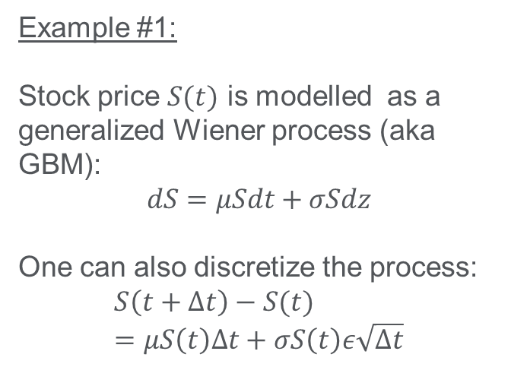
Common mathematical applications
  Stochastic calculus
  PDEs i.e., finite differences methods
  Monte Carlo methods
Example #1:
Stock price $S(t)$ is modelled as a generalized Wiener process (aka GBM):
$$dS=μSdt+σSdz$$
One can also discretize the process:
$$S\left(t+Δt\right)−S(t)=μS\left(t\right)Δt+σS\left(t\right)ε\sqrt{Δt}$$

Slide 14
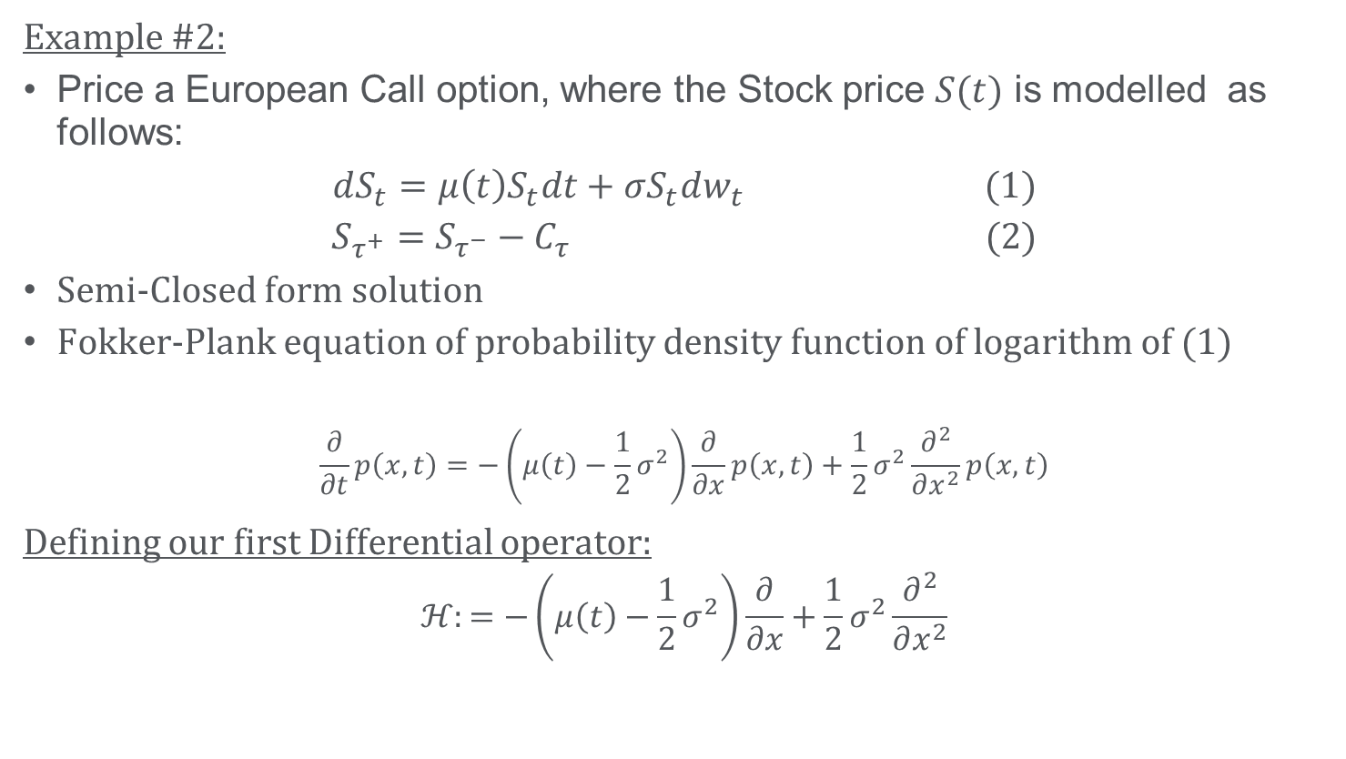
Advanced Mathematical Example
Example #2:
Price a European Call option, where the Stock price $S(t)$ is modelled as follows:
$$dS_{t}=μ\left(t\right)S_{t}dt+σS_{t}dw_{t} (1)$$
$$S_{τ^{+}}=S_{τ^{−}}−C_{τ} (2)$$
Semi-Closed form solution
Fokker-Plank equation of probability density function of logarithm of (1)
$$\frac{∂}{∂t}p\left(x,t\right)=−\left(μ\left(t\right)−\frac{1}{2}σ^{2}\right)\frac{∂}{∂x}p\left(x,t\right)+\frac{1}{2}σ^{2}\frac{∂^{2}}{∂x^{2}}p\left(x,t\right)$$
Defining our first Differential operator:
$$ℋ:=−\left(μ\left(t\right)−\frac{1}{2}σ^{2}\right)\frac{∂}{∂x}+\frac{1}{2}σ^{2}\frac{∂^{2}}{∂x^{2}}$$

Slide 15
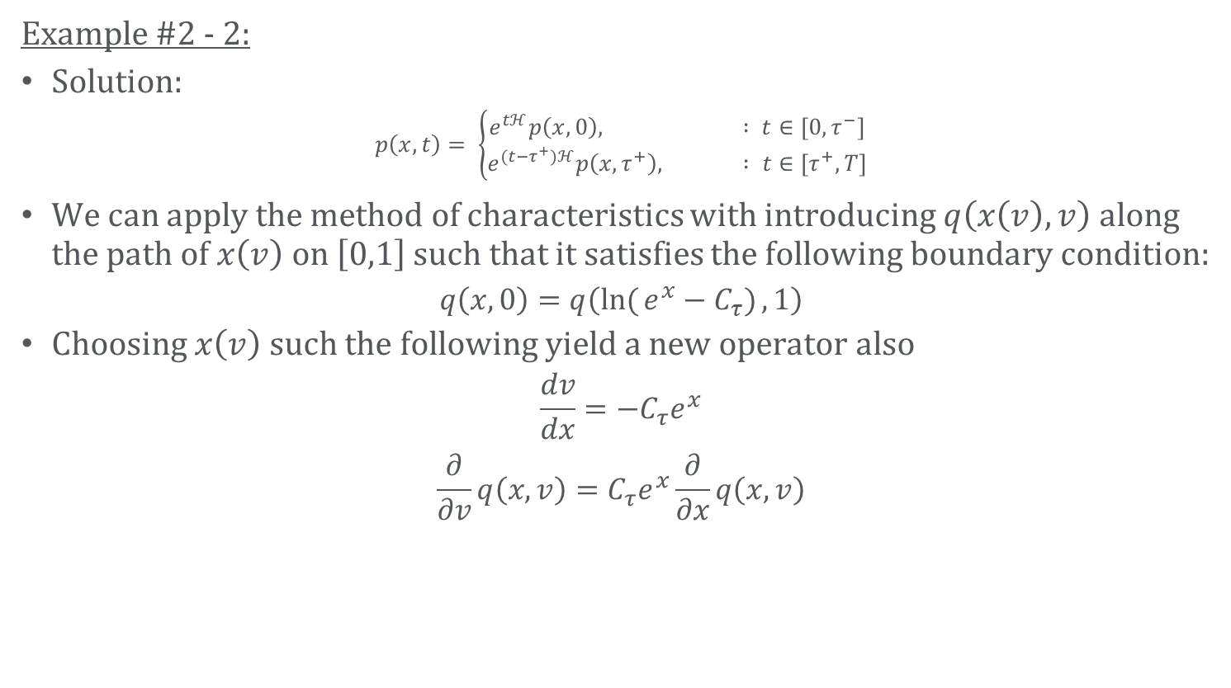
Advanced Mathematical Example - cont.
Example #2 - 2:
Solution:
$$p\left(x,t\right)= \left\{\begin{aligned}e^{tℋ}p\left(x,0\right), : t∈\left[0,τ^{−}\right] \\ e^{(t−τ^{+})ℋ}p\left(x,τ^{+}\right), : t∈\left[τ^{+}, T\right]\end{aligned}\right.$$
We can apply the method of characteristics with introducing $q\left(x\left(v\right),v\right)$ along the path of $x\left(v\right)$ on $\left[0,1\right]$ such that it satisfies the following boundary condition:
$$q\left(x,0\right)=q\left(ln({e^{x}−C_{τ})},1\right)$$
Choosing $x\left(v\right)$ such the following yield a new operator also
$$\frac{dv}{dx}=−C_{τ}e^{x}$$
$$\frac{∂}{∂v}q\left(x,v\right)=C_{τ}e^{x}\frac{∂}{∂x}q\left(x,v\right)$$

Slide 16
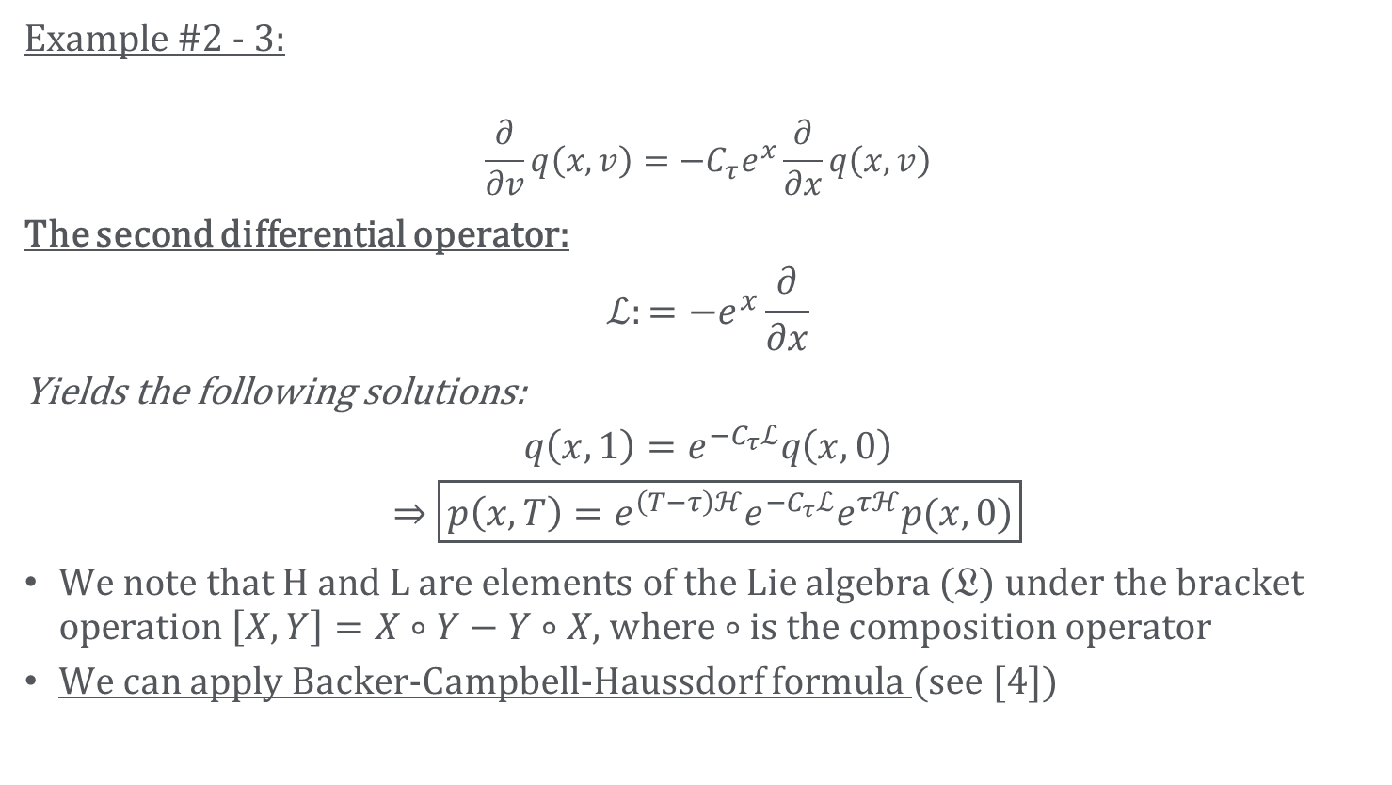
Advanced Mathematical Example - cont.
Example #2 - 3:
$$\frac{∂}{∂v}q\left(x,v\right)=−C_{τ}e^{x}\frac{∂}{∂x}q\left(x,v\right)$$
The second differential operator:
$$ℒ:=−e^{x}\frac{∂}{∂x}$$
Yields the following solutions:
$$q\left(x,1\right)=e^{−C_{τ}ℒ}q\left(x,0\right)$$
$$⇒\boxed{p\left(x,T\right)=e^{\left(T−τ\right)ℋ}e^{−C_{τ}ℒ}e^{τℋ}p(x,0)}$$
We note that H and L are elements of the Lie algebra ($𝔏$) under the bracket operation $\left[X,Y\right]=X∘Y−Y∘X$, where $∘$ is the composition operator
We can apply Backer-Campbell-Haussdorf formula (see [4])

Slide 17
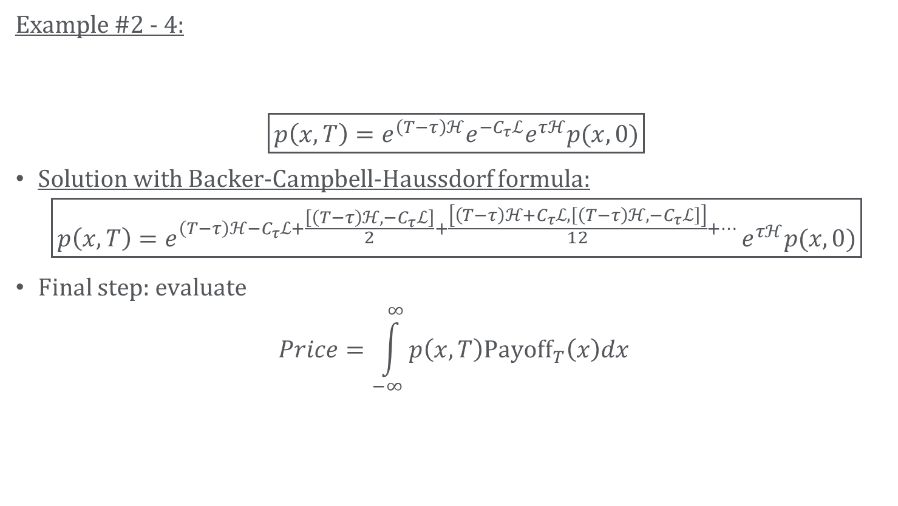
Advanced Mathematical Example - cont
Example #2 - 4:
$$\boxed{p\left(x,T\right)=e^{\left(T−τ\right)ℋ}e^{−C_{τ}ℒ}e^{τℋ}p(x,0)}$$
Solution with Backer-Campbell-Haussdorf formula:
$$\boxed{p\left(x,T\right)=e^{\left(T−τ\right)ℋ−C_{τ}ℒ+\frac{\left[\left(T−τ\right)ℋ,−C_{τ}ℒ\right]}{2}+\frac{\left[\left(T−τ\right)ℋ+C_{τ}ℒ,\left[\left(T−τ\right)ℋ,−C_{τ}ℒ\right]\right]}{12}+… }e^{τℋ}p(x,0)}$$
Final step: evaluate
$$Price=\int_{−∞}^{∞}{p\left(x,T\right)Payoff_{T}\left(x\right)dx}$$

Slide 18
Markets Quantitative Analysis
How do we work?
1. Observe Market Behavior
2. Build Mathematical Model
$$PV=\sum_{fl}{F_{i}τ_{i}{DF}_{i}}−S\sum_{fx}{τ_{i}{DF}_{i}}$$
$$PV=DF\left[FN\left(d_{1}\right)−XN\left(d_{2}\right)\right]$$
$$PV=\left(1−R\right)∗\int_{0}^{T}{DF\left(t\right)dP\left(t\right)−S\sum_{i=0}^{N}{τ_{i}DF_{i}∗(1−P\left(t_{i}\right))}}$$
3. Implementation
4. Deliver

Slide 19
Software development skills
  Coding financial math models
  Python, C++, (Perl, MATLAB)
  Data cleaning
  Testing frameworks: unit tests, regular re-evaluation of model performances
  Model documentation
  Design patterns
  Git version control
  Linux and Windows shell
  Data science and machine learning techniques
  …
Example:
Coding with numerical libraries
Interface design

Slide 20
Markets Quantitative Analysis
How do we work?
1. Observe Market Behavior
2. Build Mathematical Model
$$PV=\sum_{fl}{F_{i}τ_{i}{DF}_{i}}−S\sum_{fx}{τ_{i}{DF}_{i}}$$
$$PV=DF\left[FN\left(d_{1}\right)−XN\left(d_{2}\right)\right]$$
$$PV=\left(1−R\right)∗\int_{0}^{T}{DF\left(t\right)dP\left(t\right)−S\sum_{i=0}^{N}{τ_{i}DF_{i}∗(1−P\left(t_{i}\right))}}$$
3. Implementation
4. Deliver

Slide 21
Soft skills
  Have good written and spoken English
  Would like to work as part of a global team with the opportunity to travel to London and New York
  Would like to receive expert training
  Team work in a heterogeneous environment
Notes:
with people who sometimes look very differently at the same problem

Slide 22
Recommended readings
[1] John C. Hull: Options, Futures, and Other Derivatives
[2] Steven E. Shreve: Stochastic Calculus for Finance I-II
[3] Learn Python the Hard Way (online book), https://learnpythonthehardway.org
[4] Stanly Steinberg:
Applications of the lie algebraic formulas of Baker, Campbell, Hausdorff, and Zassenhaus to the calculation of explicit
solutions of partial differential equations,
Journal of Differential Equations,
Volume 26, Issue 3,
1977,
Pages 404-434,
ISSN 0022-0396,
https://doi.org/10.1016/0022-0396(77)90088-2.
(http://www.sciencedirect.com/science/article/pii/0022039677900882)

Slide 23
MQA Budapest Career Possibilities
Quantitative Developers
  Excellent software development skills
  Strong C++ / Python
  Interest in finance.
Quantitative Support (Devops)
  Excellent technical skills
  Python / Bash scripts
  Interest in finance.
Quantitative Analysts
  Typically Masters / PhD level
  Mathematics, Physics or Engineering
  C++, Python, or MATLAB skills.
  Knowledge of finance.

Slide 24
MQA Summer Internship program
Summer Intern program for 4+1 pre-final year students. During the internship, our interns will work side by side with our top experts in order to build, optimize, test and implement tools and features for our financial models and systems that will be used to analyze the market situation and assess investment risk
Quant Developer (BSc, MSc or PhD)
  Technical development and optimization of the analytics libraries and server components requiring software development skills in C++ or Python along with good numerical skills.
Quant Support (BSc, MSc or PhD)
  Supporting the development infrastructure, databases and productivity tools along with the build, testing and release management of the analytics libraries requiring Computer Science skills. Working in Python or Linux bash languages.
Quant (MSc or PhD)
  Research, development, optimization, documentation and performance analysis of the Financial Models used in the analytics libraries requiring a strong academic background in Mathematics and experience of programming in C++ or using MATLAB.
Trading Associate (BSc, MSc or PhD)
  Supporting senior traders, developing and back-testing trading strategies, requiring good numerical skills and experience of analysis in Excel and Python.
Eligibility: Currently completing a BSc/MSc/PhD at a Hungarian institution in Computer Science, Engineering, Mathematics, Physics, Finance, Economics, or similar

Slide 25
Thanks for your attention!
Q & A
Visit jobs.citi.com + keywords: Internship + Budapest

