Slide 1
„Beyond Corona” Forum
Proposal for participation in the program
Kanazawa University in cooperation with HEPA and HEPA Regiopnal Office in Japan
2020.07.03.

Slide 2
1. Beyond Corona Forum program description
Organizer: Kanazawa University Japan
Objective: Involve young talent in finding the answers for the
social and economic challenges of the post COVID era
Method: Internet competition by 5 minutes video pitch
/community voting
Participants: Student goups from Hungary and Japan
Time frame: May 28 2020 – January 31 2021
01

Slide 3
2. Beyond Corona Forum program phases
Invite student groups to join the program
Upload 5 minutes video pitch
Workshops, discussions with Japanese and Hungarian mentors
Online voting by internet community
Realization of winning ideas
01

Slide 4
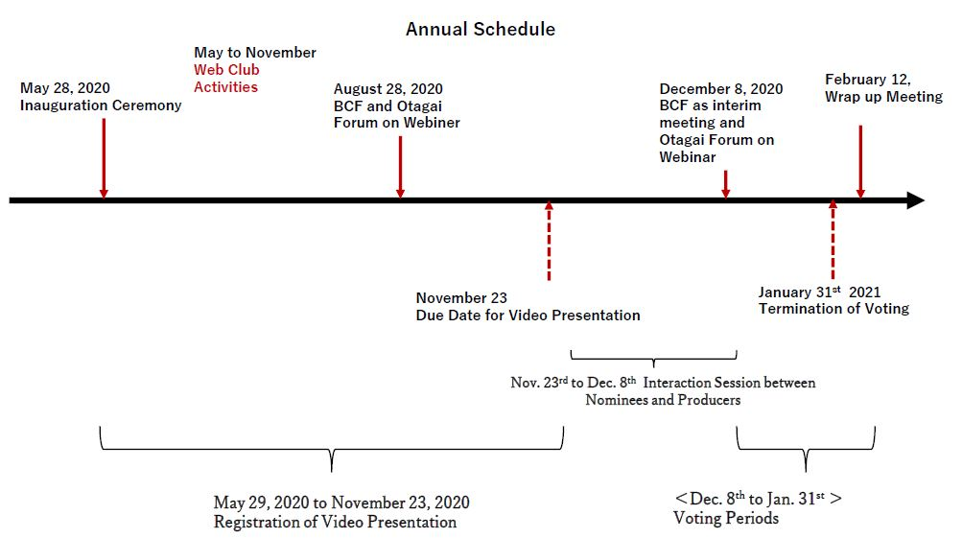
3. Beyond Corona Forum time schedule
01

Slide 5
6. Beyond Corona Forum Kanazawa University project contact
Dr. Daisuke Matsushima
Doctor (DBA) / Professor
Faculty of Transdisciplinary Science
Institute of Transdisciplinary Science
Kanazawa University
Phone: +81-90-7224-0414
Mail: matsushimad@staff.kanazawa-u.ac.jp
01

Slide 6
Appendix 1.
01

Slide 7
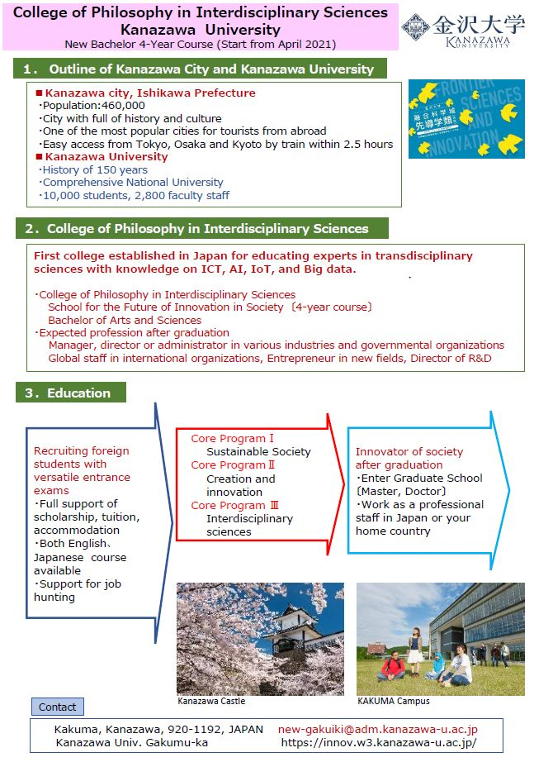
Appendix 2.
01

